Slide 1

Object Oriented Programming

Slide 2

Syllabus
Pre Training – Programming
Training
Introduction to Object-Oriented Programming (OOP)
Topics: Classes, objects, inheritance, and encapsulation.
Hands-On: Create a class for a product catalog.
Post Training – Case Studies, Certification study material

Slide 3
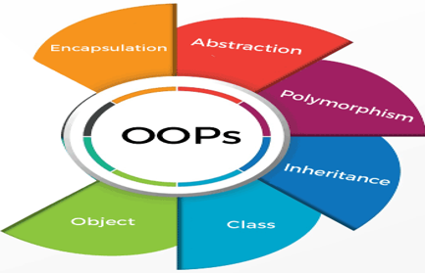
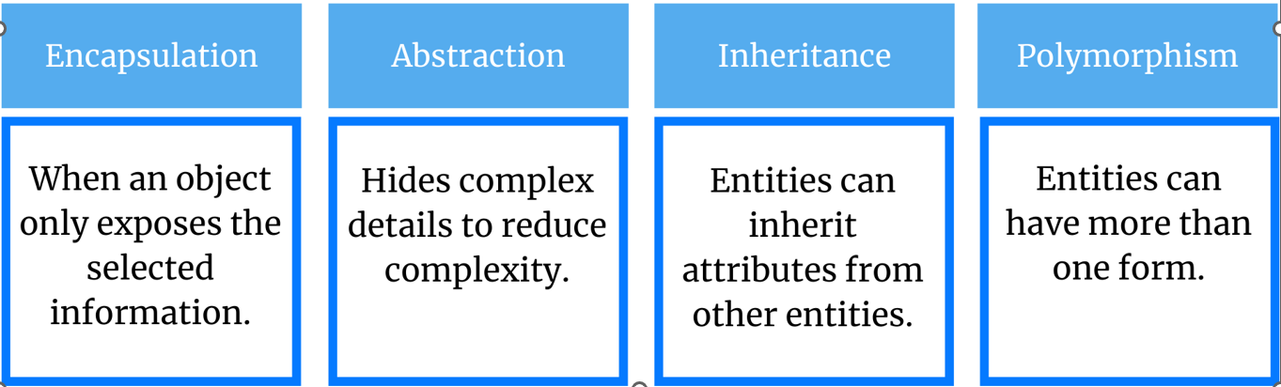
Object-Oriented Programming (OOP)
OOP is a computer programming model that organizes software design around objects and data, instead of logic and functions.

Slide 4
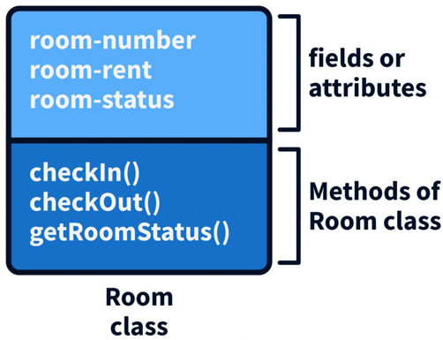

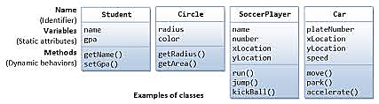
Class
A class is a blueprint or template for creating similar types of objects.
It mimics real world object creation.
Classes are a user-defined data type that defines two things:
Attributes (data fields)
Behavior (functions or methods)

Slide 5

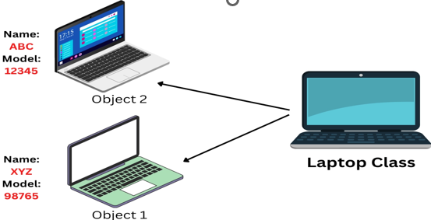
Objects
Objects are like "things" that have:
Attributes (what they have, a car has a color or speed).
Methods (what they can do, a car can drive or stop).
State: The current values of each attribute (Static or Dynamic).
Behavior: How an object behaves and responds regarding state transitions.
Identity: How distinct an object is from all other objects.
Responsibility: The function that it performs within the object.
Ex: Student object.
State: Name, Age, Gender, Address.
Behavior: Reading, Writing, Running.
Identity: ID, Registration Number.
Responsibility: To study and get good marks.

Slide 6
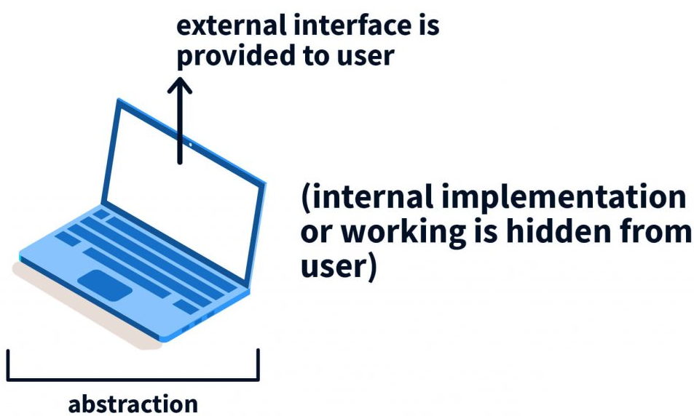
Abstraction
Abstraction involves showing only necessary details to the user and hiding irrelevant details or unnecessary details from the user.
It is an extended form of Encapsulation and serves a security purpose.
It simplifies by modeling classes appropriate to the relevant level of inheritance for a particular problem.

Slide 7
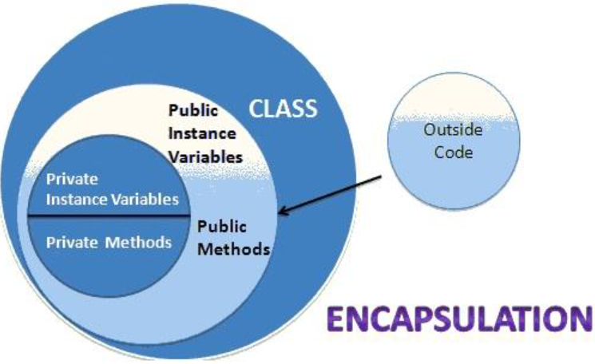
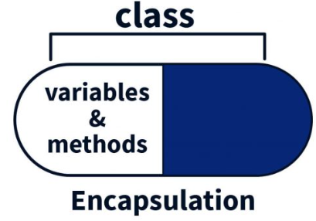
Encapsulation
Encapsulation: A technique of hiding the internal state of an object and requiring all interaction to be performed using object's methods to protect the integrity of the data.
Public methods or variables(fields) are accessible both from the same class as well as from outer classes.
Private methods or variables(fields) are accessible only with in the class.

Slide 8
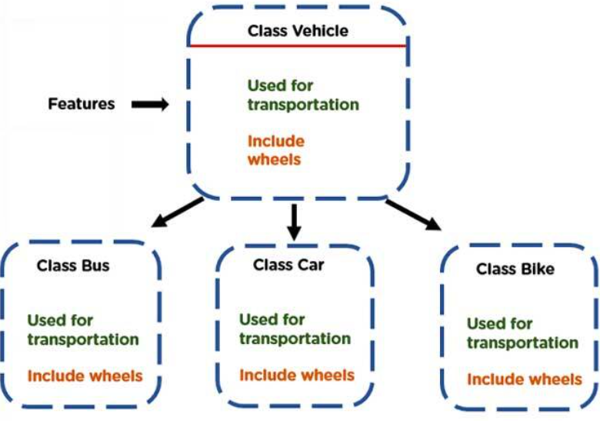
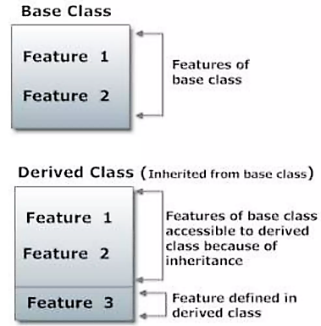
Inheritance
Inheritance allows a class to inherit characteristics (methods and properties) from another class.
When we create a class, we need not write all the properties and functions again, as these can be inherited from another class that possesses it.
It supports code reusability, reduces redundancy and simply maintenance

Slide 9
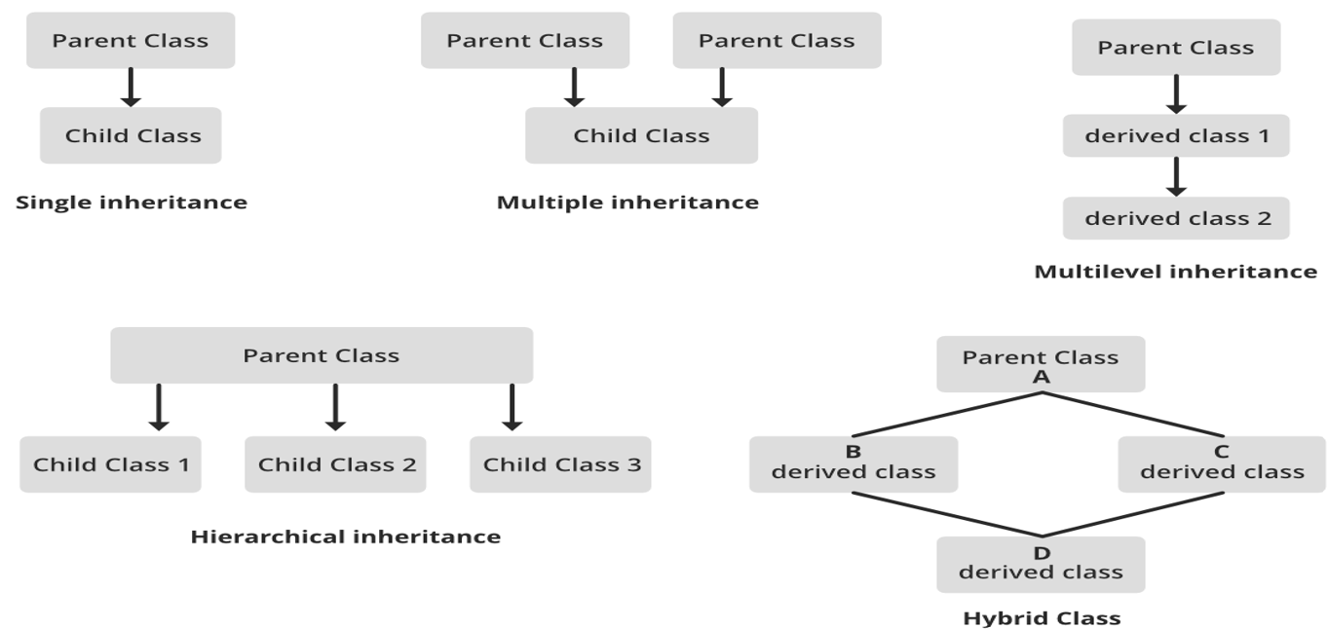
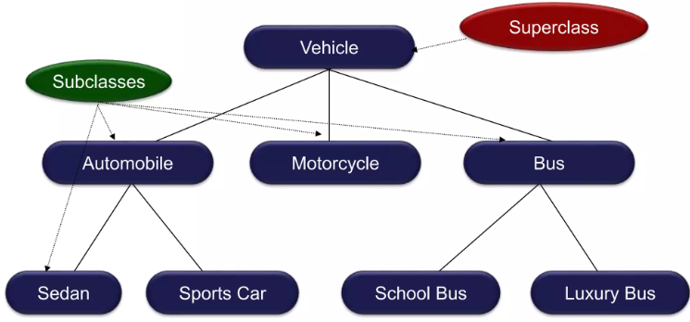
Inheritance

Slide 10
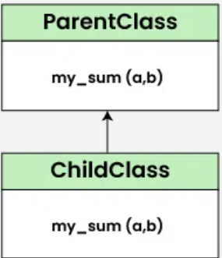
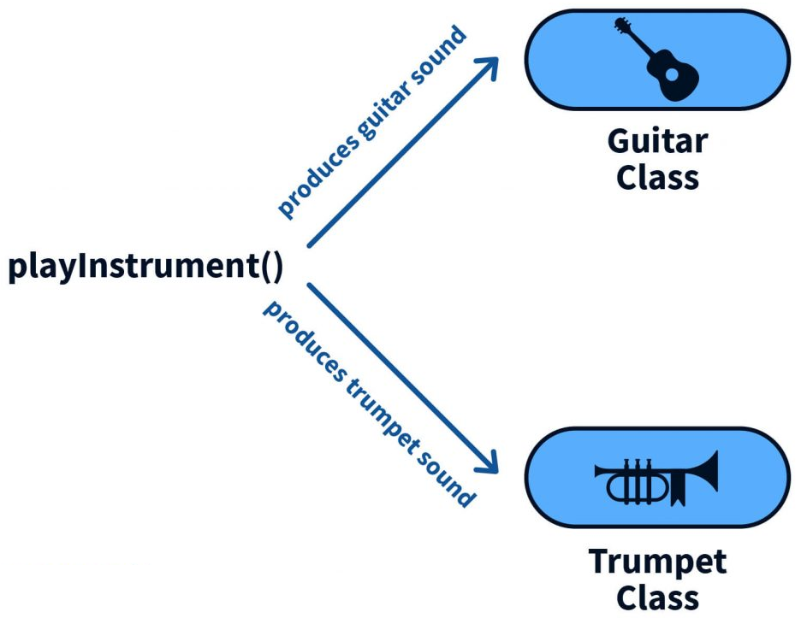
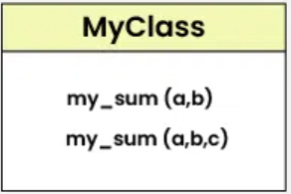
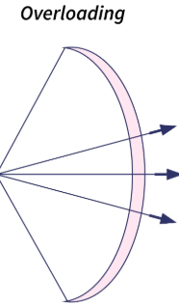
Polymorphism
Polymorphism is an ability of Objects to be used in various contexts without modifying the object itself.
Function overriding: A child class can exhibit different implementation of a function defined in parent class
Function overloading: Methods can have the same name but the number of arguments is different in function calls

Slide 11
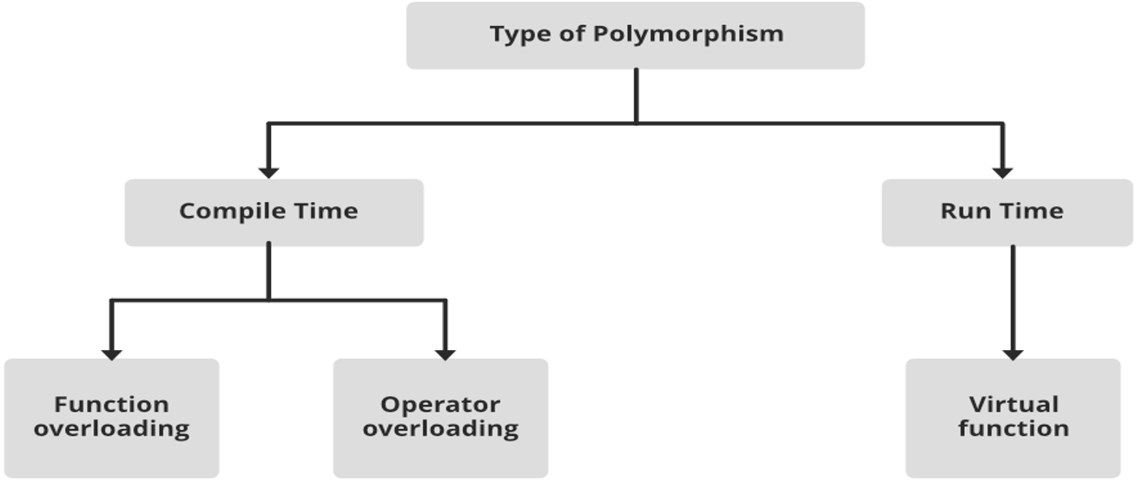
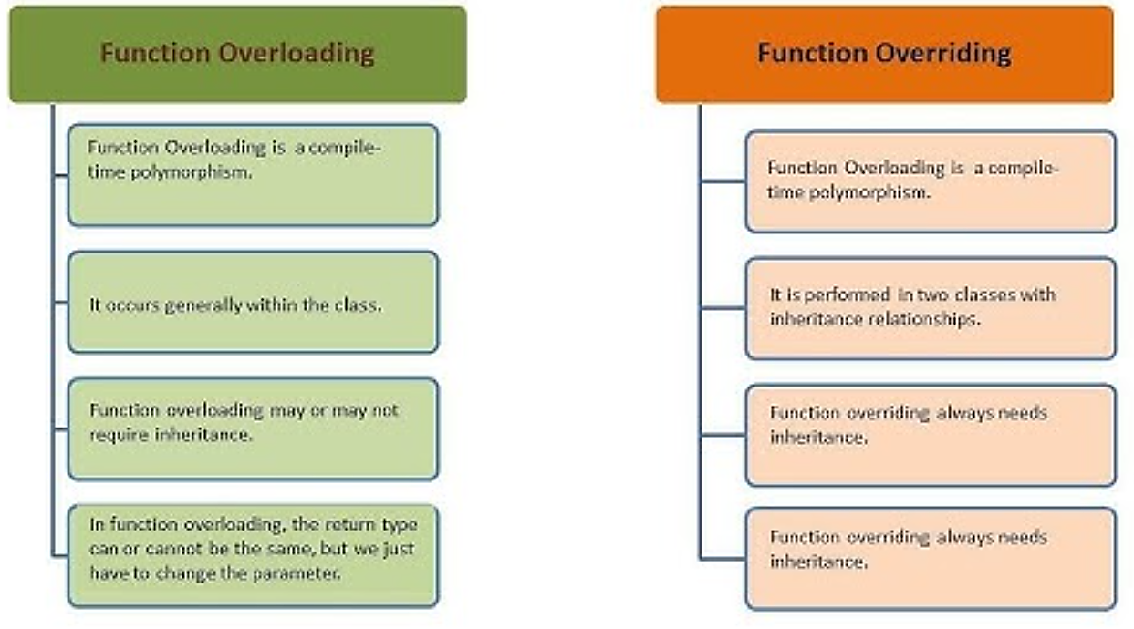
Polymorphism

Slide 12
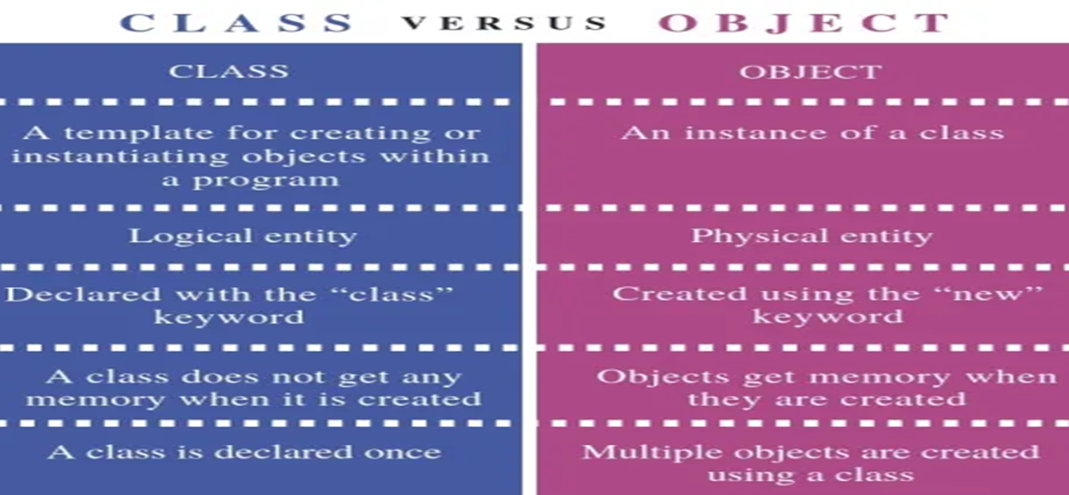
Class vs Object

Slide 13
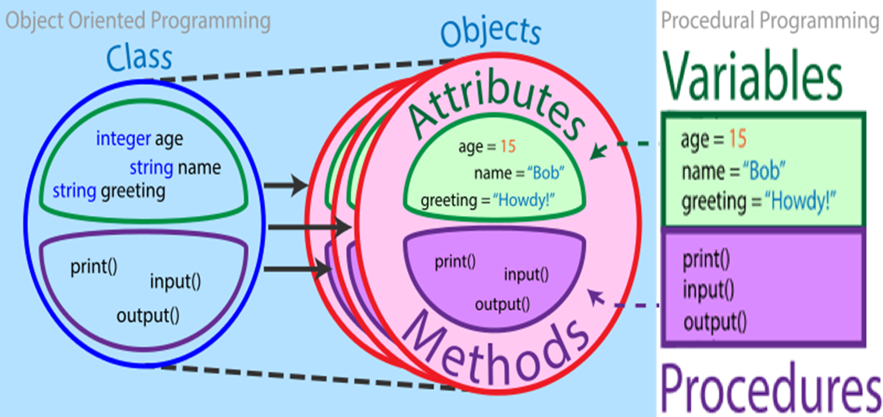
Object Oriented Programming vs Procedural Programming

Slide 14
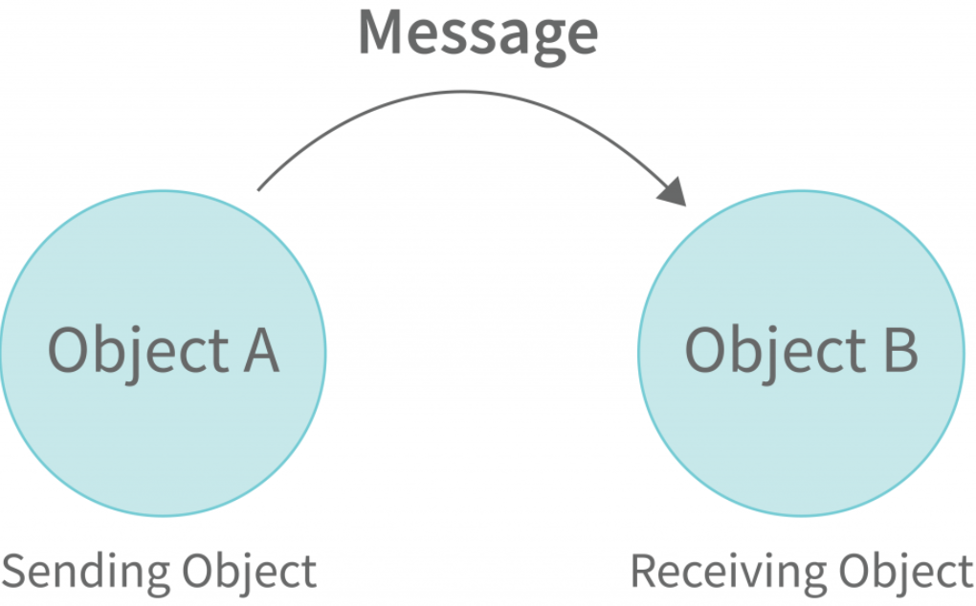
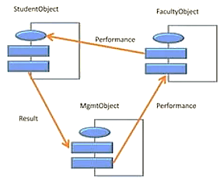
Message
Objects communicate with one another by sending and receiving information to each other.
The sender object specifies the name of the object, the name of the function, and the task to be performed
The receiver object will invoke the function that generates the desired results and send the results.

Slide 15
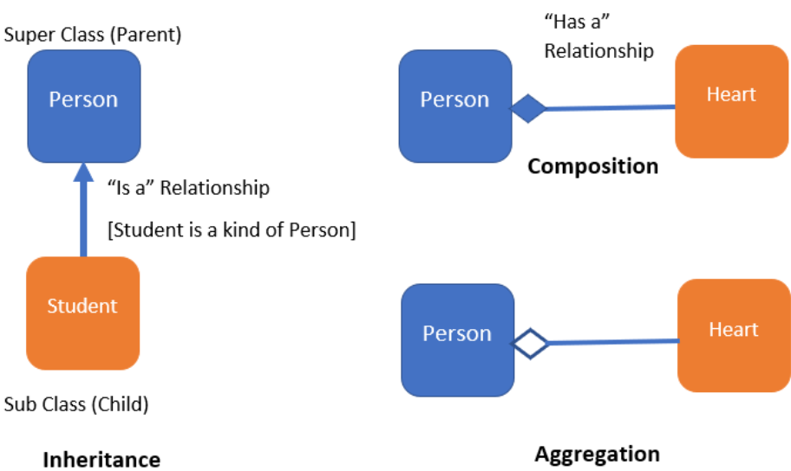
Composition, Aggregation, Relationship

